Slide 1
Graphical Languages
Vector and raster displays are two substantially different hardware technologies fro creating images on the screen
Raster display now dominant hardware technology because they support several modern applications like:
fill area with uniform colors repeated patterns in two or
more colors vector can only simulate filled areas with
closely spaced sequences of parallel vectors
raster display stores images in pixel forms and can read
or write moved copies or any manipulations

Slide 2
Software Standards
(Need for Machine Independent Graphical Languages)
Primary goal of standardized graphics software is portability
Why machine independent graphics language?
When packages are designed with standard graphics functions software can be moved easily from one hardware to another without standards, program designed for one hardware often cant be transferred to another system with out extensive rewriting of the programs.

Slide 3
Software Standards
(Need for Machine Independent Graphical Languages)
In international and national standards organizations in many countries have cooperated in an effort to develop a generally accepted standards for computer graphics
“Graphical Kernel System(GKS)” was adopted as the first graphics software standard by the international standard organization and others like ANSI
Original GKS was 2D and later on 3D extension was developed

Slide 4
Software Standards
(Need for Machine Independent Graphical Languages)
Second standard “Programmers Hierarchical interactive graphics standard (PHIGS) is an extension of GKS with increased capabilities for object modeling, color specifications surface rendering and picture manipulations.
An extension of PHIGS called PHIGS+ was developed to provide 3D surface shading capabilities standard graphics functions are defined as a set of specifications that is independent of any programming language

Slide 5
Language binding
Gives the syntax for accessing the various standard graphics functions from this language
e.g. PHIGS, GKS function for specifying a sequence of n-1 connected 2D straight line segment polyline (n,x,y)
- FORTRAN polyline can be drawn with GPLCALLGPR(n,x,y) where x, y are end points
C
gpolyline(n,pts)where pts is list of end points

Slide 6
PHIGS
PHIGS doesn’t provide a standard methodology for a graphical interface to output devices nor for storing and transmitting pictures
Separate standards developed
Device interface by Computer Graphics interface (CGI)
Computer Graphics Metafile (CGM) for achieving and transporting pictures

Slide 7
PHIGS workstation
A PHIGs workstation can be a single output a single input device an combination of input and output devices a file or even a window displayed on a video monitor
OpenPhigs(errorFile, memorySize)
OpenWorkstation(ws, Connection, type){
Create and display picture
}
CloseWorkstation(ws)
ClosePhigs
Parameter errorfile is to contain any error message that are generated
memorysize specifies the size of the internal storage area
Workstation identifier (as integer) as ws
connection states the access mechanism for the workstation
Type specifies the particular category such as input, output device a combination “out in” device or an input or output metafile

Slide 8
1. PHIGS concept and graphical workstation
PHIGS is a high level graphics library with over 400 functions.
It allows an application programmer to describe a model of a scene, to display the model on workstation, to manipulate and to edit the model interactively
The models are stored in a graphical database known as centralized structure store (CSS).
The fundamental entity of data is a structure element and these are grouped together into units called structures.
Structures are organized as acyclic directed graphics called structure networks

Slide 9
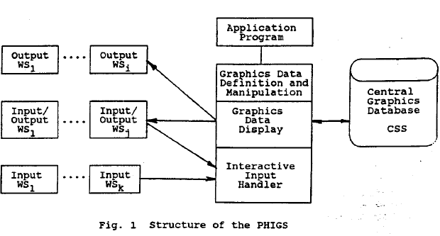
PHIGS workstation

Slide 10
PHIGS workstation
A PHIGS workstation represents a unit consisting of zero or one display surfaces and zero or more input devices such as keyboard, tablet , mouse and light pen.
The workstation presents this devices to the application program as a configuration of abstract devices thereby shielding the hardware peculiarities
Workstation type:
  OUTPUT – supports output only
  INPUT – supports input only
  OUTIN – supports output and input
  MO – supports output graphical and application data to the external storage
  MI- supports input graphical and application data from the external storage to the application

Slide 11
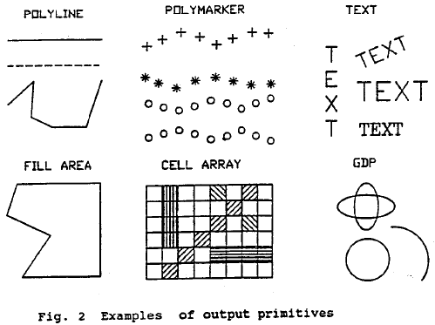
PHIGS
Picture generated by PHIGS are build up of basic pieces called output primitives. Output primitives are generated from structure elements by structural traversal
POLYLINE set of connected lines defined by point sequences POLYLINE3
POLYMARKER set of symbols of one type centered at a given position POLYMARKER 3
TEXT character string at a given position on an arbitrary plane in modeling coordinate space
ANNOTATION TEXT RELATIVE character string at specified position in an x y plane parallel to view plane ANNOTATION TEXT RELATIVE 3
FILL AREA single polygonal area which may be hollow or filled with uniform color, pattern or hatch style
FILL AREA SET a set of polygonal areas which may be filled similar as FILL AREA
CELL ARRAY two dimensional array of cells with individual colo9ur4s
GENERALIZED DRAWING PRIMITIVE special geometrical output capabilities of a workstation such as the drawing of spline curves, circular arcs, elliptic arcs

Slide 12
2. Structure Entity
A structure element is the fundamental entity of data. Structure elements are used to represent application specified graphics data for output primitives, attribute selections, modeling transformations and clipping , invocation of other structures, and to represent application data.
The following types of structure elements are defined in PHIGS
Output primitive structure elements
Attribute specification structure elements
Modeling transformation and clipping structure elements
Control structure element
Editing structure element
Generalized structure element
Application data
Graphical output

Slide 13
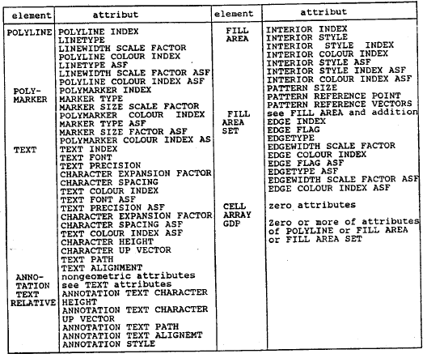
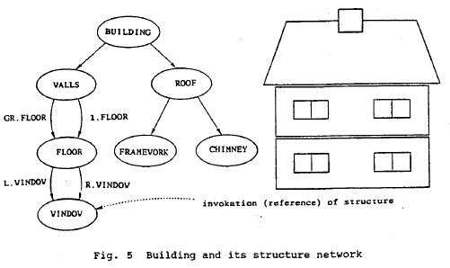
3. Structure and structure networks
PHIGS supports the storage and manipulation of data in CSS the CSS contains graphical and application data organized into units called structures which may be related each other hierarchically to form structure networks

Slide 14
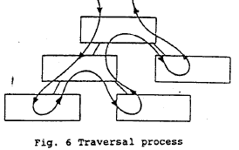
Graphical Output
Structure traversal and display
A structure network is identified for display on a workstation by posting function POST STRUCTURE
A structure may be displayed only if it is a member of a posted structure network
To display a network the structure elements have to be extracted from the CSS and processed . that process is called traversal process
The traversal process interprets each structure element in the structure network sequentially starting at the first element of the top of the network
A traversal state list is associated with each traversal process. Values in this state list ;may be accessed when the structure elements are interpreted
Each time a traversal is initiated the associated list is initialized

Slide 15
PHIGS
Structure editing
Each element within a structure can be accessed and modified individually with editing functions to inset new elements, replace elements with new structure elements, delete structure elements. Functions for positioning element pointer
SET ELEMENT POINTER – set to an absolute position
SET OFFSET ELEMENT POINTER – set relative to current position
SET ELEMENT POINT AT LABEL – set a position of the specified label structure element
`The edit mode defined by the function SET EDIT MODE defines whether new elements replace the element pointed to by the element pointer or are added after the element pointed to by the element pointer
Functions for editing:
COPY ALL ELEMENTS FROM STRUCTURE- copy all the elements of a structure into the open structure
DELETE ELEMENT – delete element at which the element pointer is pointing
DELETE ELEMENT RANGE- delete a group of elements between two element positions
DELETE ELEMENT LABELS-delete group of elements delimited by labels
EMPTY STRUCTURE-delete all elements of the structure

Slide 16
PHIGS
Manipulation of structures in CSS
Operations for manipulation of structure
DELETE STRUCTURE- delete structure ;and all references to it
DELETE ALL STRUCTURES- delete all structure from the CSS
DELETE STRUCTURE NETWORK-delete the indicated structure and all its ancestors
CHANGE STRUCTURE IDENTIFIER-change identifier specified structure
CHANGE STRUCTURE REFERENCES-change all references of specified structure
ELEMENT SEARCH –search within a single structure for an element of a particular element type
Structure archival and retrieval
OPEN ARCHIVE FILE , CLOSE ARCHIVE FILE-initiates or terminates access to archive file
ARCHIVE ALL STRUCTURES-storing of structure to archive file
RETRIEVE ALL STRUCTURES- recovers structures from an archive file
DELETE STRUCTURES FROM ARCHIVE-deletes structure in an archive file

Slide 17
4. Coordinate systems and transformations
Structures represent parts of a hierarchical model of modeling scene. Each of these parts has own world space represented by modeling coordinate system .
The relative positioning of the separate parts is achieved by having a single World coordinate space onto which all the defined modeling coordinate systems are mapped by a composite modeling transformation during the traversal process
The world coordinate space can be regarded as a workstation independent abstract viewing space
Transformations perform mapping between four coordinate systems:
  World coordinates used to define uniform coordinate system for all abstract workstation
  View reference coordinate used to define a view
  Normalized projection coordinates; used to facilitate assemblies of different views
  Device coordinates: one coordinate system per workstation representing its display space

Slide 18
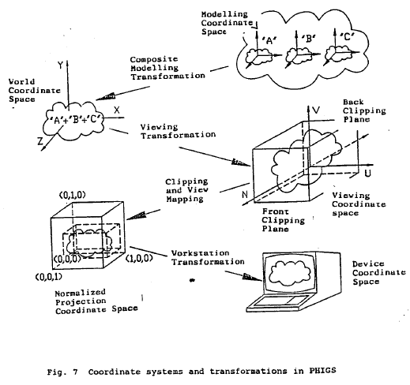

Slide 19
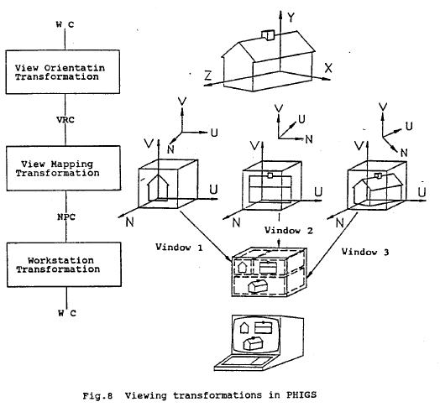

Slide 20
Graphical Output
5. Graphical input
An application program gets graphical input from an operator by controlling the activity of one or more logical input devices.
6. Language Interfaces
PHIGS defines only a language independent nucleus of a graphics system
For integration into a language, PHIGS is embedded in a language dependent layer containing the language conventions, e.g. parameter and name assignment
In case of the layer model, each layer may call the functions of the adjoining lower layers. In general the application program uses the application oriented layer, the language dependent layer, other application dependent layers and operations system resources. There are standards of the language dependent layers for the language FORTRAN, PASCAL and C

Slide 21
7. Graphics system PHIGS +
PHIGS+ enables to specify light sources
Parameters of the light sources are described and application program s may set the up
The predefined light sources are ambient, directional, positional, spot light source.
Shading method is an attribute of the graphics primitives.
  NONE- No shading COLOUR-color interpolation shading
  NORMAL-normal interpolation shading
  DOT PRODUCT- dot product interpolation shading
  Light type accepted for shading
  NONE – no reflectance calculation performed
  AMBIENT-use ambient term
  AMB_DIF-use ambient and diffuse terms
  AMB_DIF_SPEC- use ambient, diffuse and specular terms
  PHIGS+ offers additional output primitives and functions;
  COMPUTE FILL AREA SET GEOMETRIC NORMAL-compute geometric normal of the fill area set
  FILL AREA SET3 WITH DATA-creates a 3D fill area set structure element that includes color and shading data
  QUADRILATERAL MESH3 WITH DATA-creates a 3D quadrilateral mesh primitive with color and shading data
  TRIANGLE STRIP3 WITH DATA-creates a 3D triangle strip primitive with color and shading data
  NON UNIFORM B-SPLINE CURVE NURBS-crates a structure element containing the definition of a non-uniform B-Spline Curve

Slide 22
Significance of PHIGS
Portability of program
PHIGS is computer and device independent graphics system. The application program that utilize PHIGS can be easily transported between host processors and graphics devices
Sophisticated capabilities save development time
PHIGS manages the storage and display of 2D and 3D graphical data, crates and maintains a hierarchical database
Increased program performance because of fewer error conditions
Application using PHIGS have well defined inputs and outputs that minimizes errors

Slide 23
GKS (the Graphical Kernel System)
- an ANSI and ISO standard.
- standardizes 2D graphics functionality at a low level.
The main objective of the Graphical Kernel System, GKS, is the production and manipulation of pictures in a computer or graphical device independent way.
The primary purposes of the standard are:
- To provide for portability of graphics application programs.
- To aid in the understanding of graphics methods by application programmers.
- To provide guidelines for manufacturers in describing useful graphics capabilities.

Slide 24
Three Basic parts:
1. An informal exposition of the contents of the standard includes text positioning, polygonal filling etc
2. A formalization of the expository material by way of abstracting the ideas into discrete functional descriptions that contains information as descriptions of input and output parameters, the effect each function, references into the expository material, and a error description in a language independent way.
3. Language bindings. These bindings are an implementation of these abstract functions in a specific computer language such as Fortran or Ada or C.

Slide 25
Five Main GKS Primitives :
In GKS, pictures are considered to be constructed from a number of basic building blocks. These basic building blocks are of a number of types each of which can be used to describe a different component of a picture.
The five main primitives in GKS are:
Polyline: Draws a sequence of connected line segments.
Polymarker: Marks a sequence of points with same symbol.
Fill area: Displays a specified area with filled intensity.
Text: Draws a string of characters.
Cell array: Displays an image composed of a variety of colours or grey scales.
Associated with each primitive is a set of parameters which is used to define particular instances of that primitive.

Slide 26
Example
The parameters of the Text primitive are the string or characters to be drawn and the starting position of that string.
TEXT(X, Y, 'ABC')
will draw the characters ABC at the position (X, Y).
GKS needs to know the height of a character string and the angle at which it is to be drawn.
These additional data are known as attributes.

Slide 27
GKS Output Primitives
GKS standardizes a reasonably complete set of functions for displaying 2D images.
It contains functions for drawing lines, markers, filled areas, text, and a function for representing raster like images in a device-independent manner.
In addition to these basic functions, GKS contains many functions for changing the appearance of the output primitives, such as changing colors, changing line thicknesses, changing marker types and sizes etc.
The functions for changing the appearance of the fundamental drawing functions (output primitives) are called attribute setting functions.

Slide 28
Polyline
It is a GKS function for drawing line segments
The polyline function takes an array of X-Y coordinates and draws line segments connecting them.
Attributes that control the appearance of a polyline:
Linetype, which controls whether the polyline is drawn as a solid, dashed, dotted, or dash-dotted line.
Linewidth scale factor, which controls how thick the line is.
Polyline color index, which controls what color the line is.
POLYLINE(N, XPTS, YPTS) where XPTS and YPTS are arrays
giving the N points (XPTS(1), YPTS(1)) to (XPTS(N), YPTS(N)).
The Polyline generated consists of N - 1 line segments joining adjacent points starting with the first point and ending with the last.

Slide 29
Polymarker
The Polymarker function allows drawing marker symbols centered at coordinate points specified.
Attributes that control the appearance of polymarkers:
Marker: specifies one of five standardized symmetric characters to be used for the marker.
The five characters are dot, plus, asterisk, circle, and cross.
Marker size: scale factor that controls how large each marker is (except for the dot marker).
Polymarker color index: Specifies the marker color
GKS provides the primitive polymarker marks a set of points, instead of drawing lines through a set of points.

Slide 30
Polymarker
A Polymarker is generated by the function:
POLYMARKER(N, XPTS, YPTS)
where the arguments are the same as for the Polyline function, namely XPTS and YPTS are arrays giving the N points (XPTS(1), YPTS(1)) to (XPTS(N), YPTS(N)).
Polymarker places a centered marker at each point.
GKS recognizes the common use of markers to identify a set of points in addition to marking single points and so the marker function is a polymarker.
POLYMARKER(l9, XDK, YDK)

Slide 31
Text
The text function allows drawing a text string at a specified coordinate position.
Attributes that control the appearance of text:
Text font and precision: Specifies text font for the characters and precision of their representation to adhere to the settings of the other text attributes.
Character expansion factor: Controls the height-to-width ratio of each plotted character.
Character spacing,: Specifies the additional white space needed to be inserted between characters in a string.
Text color index, which specifies what color the text string should be.

Slide 32
Text
Character height: Specifies the height of the characters
Character up vector: Specifies the angle of the text drawn
Text path: Specifies in the direction the text should be written (right, left, up, or down).
Text alignment: Specifies vertical and horizontal centering options for the text string.
A text string may be generated by invoking the function:
TEXT(X, Y, STRING) where (X, Y) is the text position and STRING is a string of characters.

Slide 33
Text
The character height attribute determines the height of the characters in the string. Since a character in a font will have a designed aspect ratio, the character height also determines the character width. The character height is set by the function:
SET CHARACTER HEIGHT(H)
where H is the character height.
The character up vector is perhaps the most important text attribute. Its main purpose is to determine the orientation of the characters. However, it also sets a reference direction which is used in the determination of text path and text alignment. The character up vector specifies the up direction of the individual characters. It also specifies the orientation of the character string in that. By default, the characters are placed along the line perpendicular to the character up vector. The function:
SET CHARACTER UP VECTOR(X, Y)

Slide 34
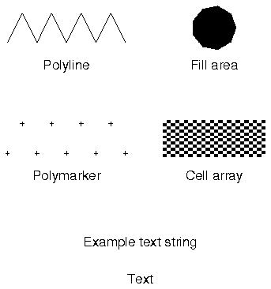
GKS

